Slide 1
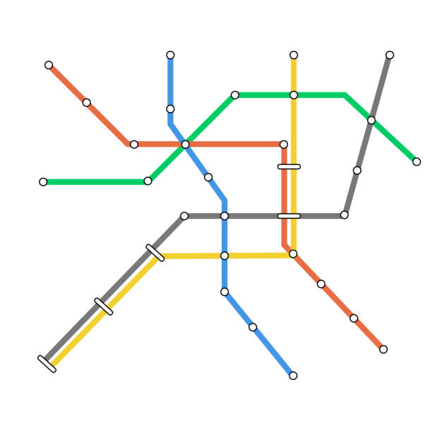
Lessons for the MTA
Exploring the Changing Needs of NYC's Commuters by Creating Algorithmically Optimized Bus Routes
Github Link

Slide 2
Table of contents
01
02
03
04
05
06
Investigation and inspiration
Data and exploratory analysis
Modeling the best bus route over time
Conclusions
Bonus mini-analysis: commutes & political divisions
Extra slides

Slide 3
01
Investigation and inspiration

Slide 4
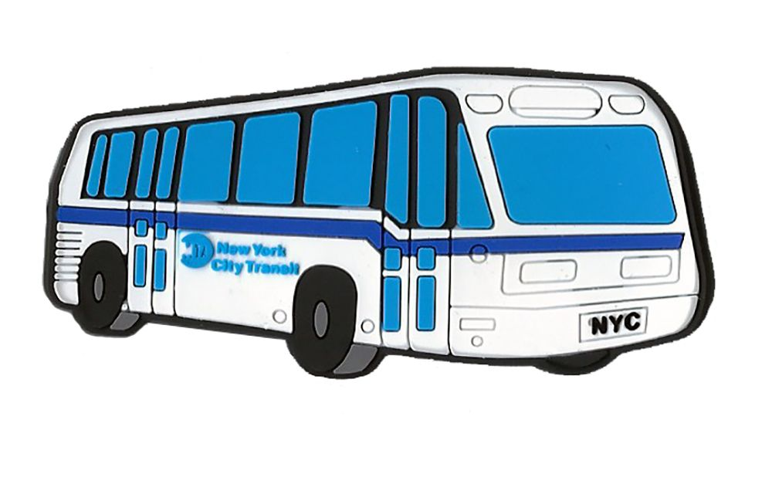
Investigation
Research Question
How quickly does the MTA need to plan and implement bus routes for them to be relevant and optimal, given the changing nature of traffic needs in NYC?

Slide 5
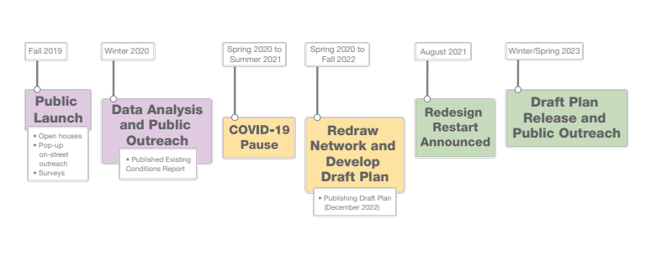
Inspiration: MTA’s slow process
MTA released a document on the Brooklyn bus design plan that included a 4-year gap between first steps and the release of the draft plan.
Adams administration is expected to have built just 22 miles of its promised 150 new miles of routes in 2023.
New routes are tied up in politics and a long review process.
This led me to a basic question: are traffic patterns changing faster than the MTA can plan and implement a bus route?
Notes:
+ basic q from slide 3

Slide 6
02
Data and exploratory analysis

Slide 7
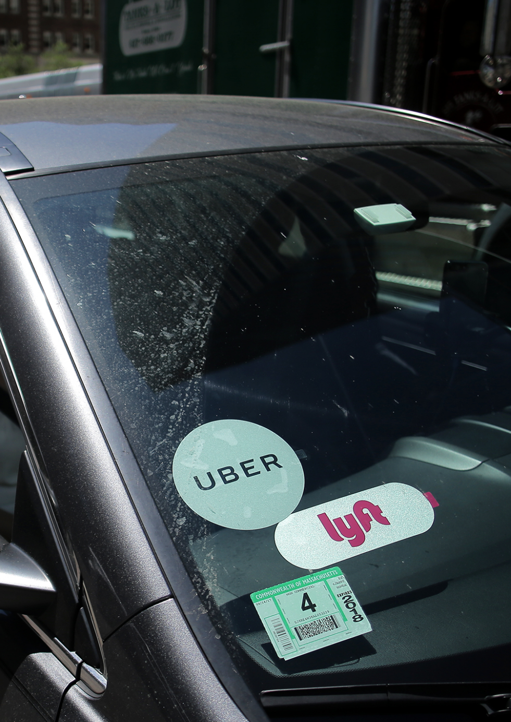
Dataset
NYC’s public data on for-hire vehicles aka rideshares:
43.9% of Midtown Manhattan traffic is rideshare traffic
Each month contains tens of millions of rows, one for each ride.
Goal: create optimal bus routes by gauging demand through a dataset of rideshare rides that includes pickup and dropoff locations.
Ultimately, we want the bus to pick up rideshare riders instead of them calling an Uber or Lyft.
Notes:
*

Slide 8
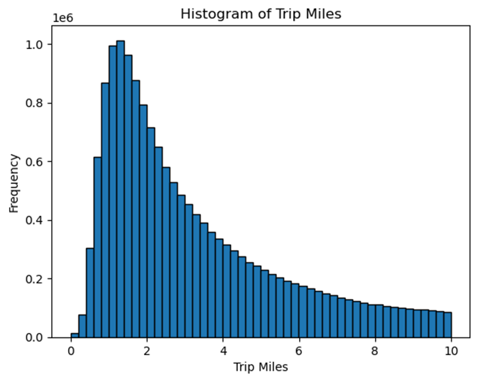
Most rides are short
Trip length peaks at a little over a mile then declines exponentially. This graph is from January 2023 but is reflective of averages throughout the dataset.
Notes:
*

Slide 9
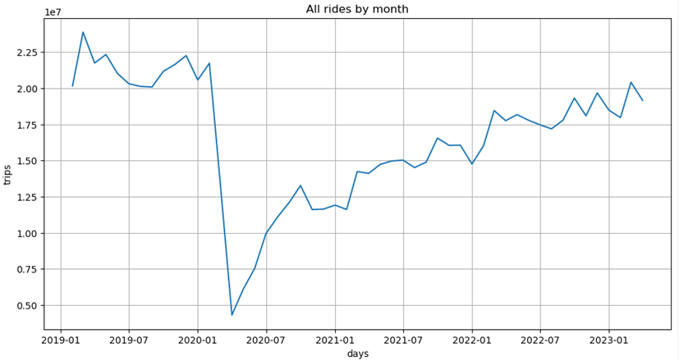
Pandemic decline and recovery
Rideshare trips declined dramatically when Covid hit in March 2020 then slowly recovered.
Notes:
*

Slide 10
03
Modeling the best bus route over time

Slide 11
Process
Created a dataframe that stated which taxi zones were adjacent to each other using GeoPandas.
Checked adjacency dataframe by using Tableau’s mapping tool. Added bridges and tunnels. Then put into a NetworkX graph.
Modeled lowest-traffic route from each zone to each zone and built an application in Tableau to display best routes.
Created custom algorithm to find bus route that could theoretically replace the largest number of rideshare rides.
Used 15 real proposed bus routes to model the ‘best’ route each quarter over a 5.75 year period.
Evaluated change over time by mapping and observing changes, then creating a custom metric of difference between routes.
Notes:
*

Slide 12
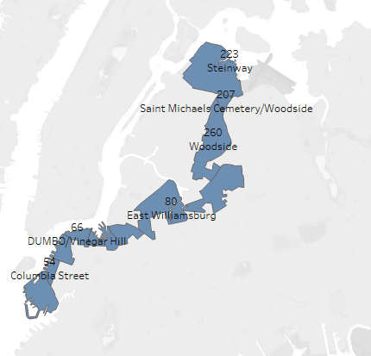
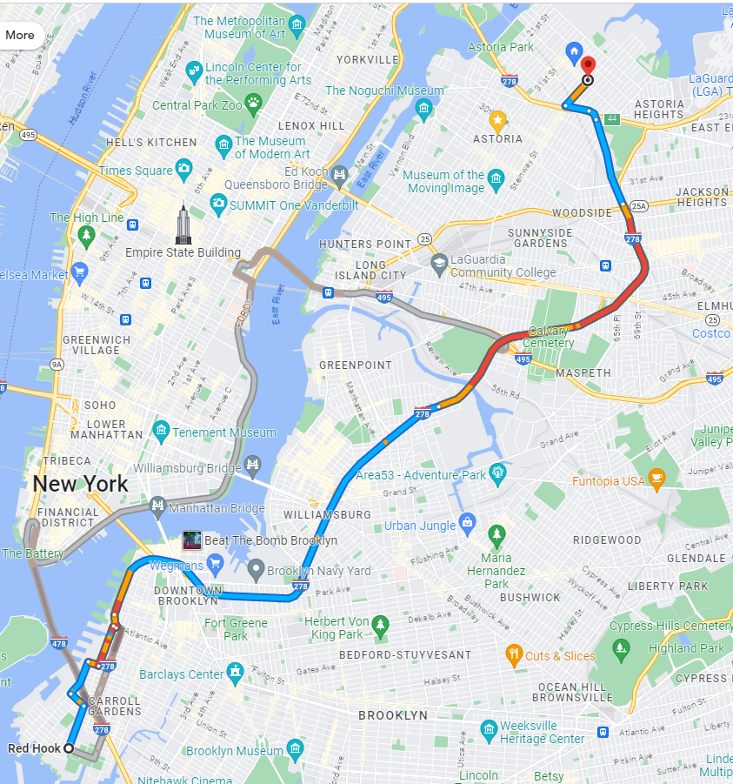
Route-finder application for drivers
Shortest path
To test the value of my data within a graph theory network, I mapped the ‘shortest path’ from all zones to each other, weighted by adjacent traffic.
In other words: the route with the least amount of total rideshare traffic, based on 2022 data.
My application did a reasonably good job at avoiding high traffic areas and creating similar routes to Google Maps.
You can play with the full application here.
Notes:
*

Slide 13
Custom algorithm for best bus route
Goal
Create an algorithm that finds a bus route that could theoretically replace the maximum number of rideshare rides, if every rideshare rider were to take the bus instead of a rideshare.
Requirements
Method
Begins in Zone A
Ends in Zone B
Does not traverse the same zone >1x
Does not traverse more than a set number of zones
Maximizes potential commutes replaced. Commutes means all commutes in a route. So a route through [A,B,C,D] covers (A,B),(A,C),(A,D),(B,C),(B,D),(C,D).
NetworkX’s ‘all simple paths’ algorithm gives all routes that meet requirements 1-4. I set the maximum number of zones at 1.5 * the unweighted shortest path length for that route — a judgement that would give the route enough slack to change while not creating overly complicated routes.
I created dictionaries of all commutes and weights (total trips and total fare cost), given a set time period. Finally, I converted each route given by the all simple paths algorithm into a list of commutes, and weighted each route by summing the weights of their commutes. The ‘best route’ is the one with the highest weight.
Notes:
*

Slide 14
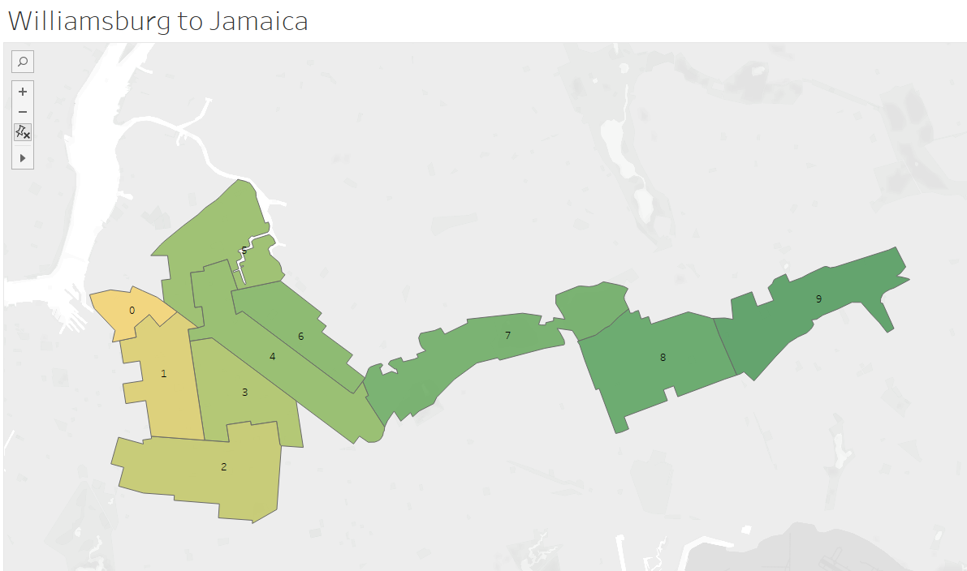
Running the model
I ran the model for 15 bus routes proposed by the MTA in Brooklyn for every quarter of available data.
For total number of trips replaced: 2017 Q3 to 2023 Q1. For total cost of fares replaced: 2019 Q1 to 2023 Q1.
The route to the right could theoretically replace 208K commutes in 2019 Q1.
View all 15 routes change over time.
Notes:
*

Slide 15
04
Conclusions

Slide 16
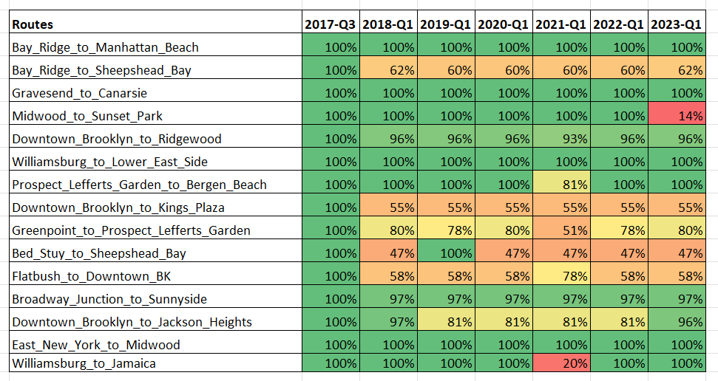
Conclusion: the routes produced by the ‘best bus route’ algorithm are generally static over multi-year periods, indicating an underlying stability to NYC’s traffic patterns.
10 of 15 routes were >95% similar in the first quarter as in the last.
12 of 15 routes were > 95% similar in at least one of the four final quarters.
Just 3 routes had sustained, substantial changes from the starting point.
Stability was more pronounced when weighting by fare cost than by total number of trips.
Notes:
(could combine with the one before)

Slide 17
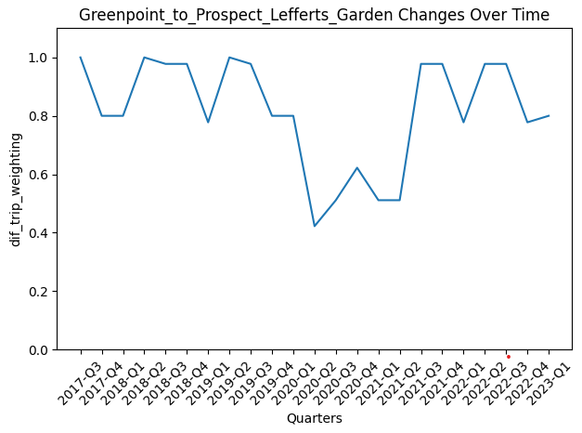
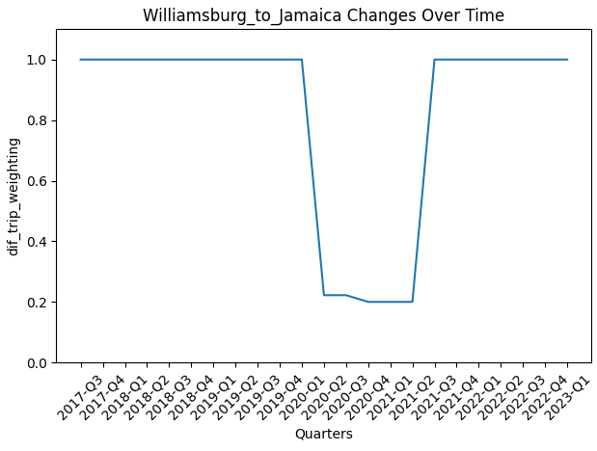
Conclusion: Pandemic change was mostly temporary.

Slide 18
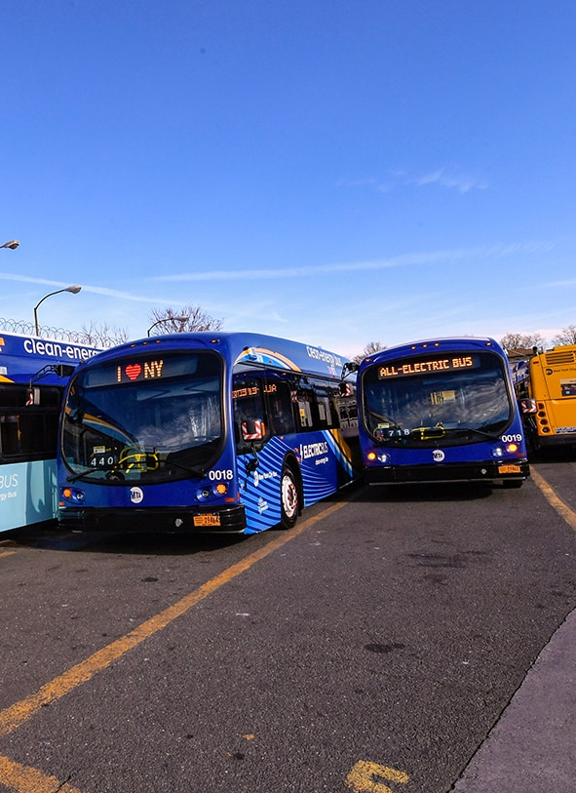
Takeaways for the MTA
NYC’s traffic patterns are usually stable and the MTA can estimate a bus route will be relevant for at least 5 years.
No need for continuous optimization e.g., a market system – a deliberate, periodic process that ‘gets it right’ twice a decade will work.
By running frequent buses that stop along high-traffic corridors, you can reduce the maximum amount of traffic. Most people just want to travel a short distance in a busy area!
Similarly, a huge amount of demand simply lies in circulating through relatively busy areas.
Reducing trips and reducing economic waste on rideshare rides are not at odds: both algorithms created similar routes.

Slide 19
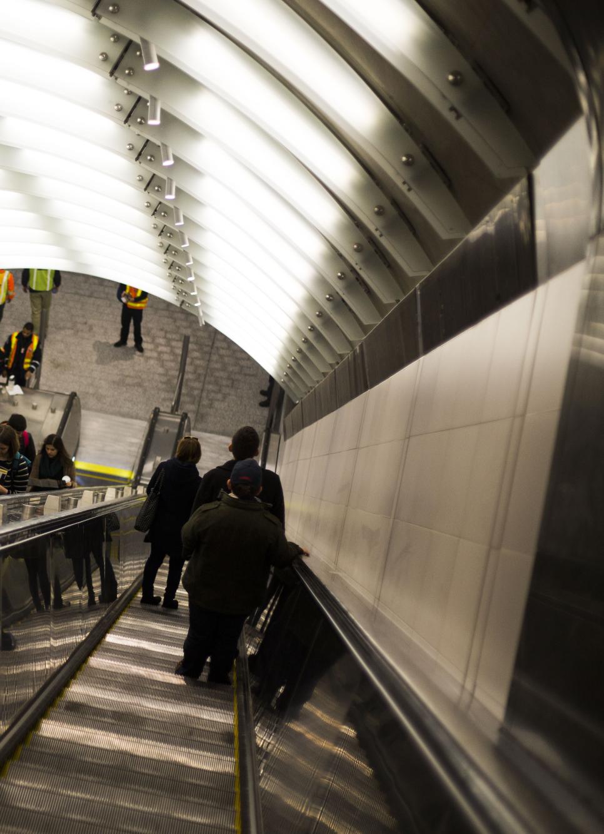
Future projects
Run this model and analysis for bus routes throughout all five boroughs. Discover which areas are increasingly favored by the algorithm and which areas are increasingly less favored.
Regarding areas where rideshare usage has increased and the ‘best bus route’ algorithm has begun to favor: how can we predict what these areas will be? E.g., would an uptick in construction permits help model where traffic will increase?
Explore more deeply the connection between commuting patterns and voting patterns. Can these patterns be used to model a future election? (see next slides)

Slide 20
Resources
Data
Data on for-hire vehicles: https://www.nyc.gov/site/tlc/about/fhv-trip-record-data.page
MTA’s Brooklyn Bus Network Redesign: https://new.mta.info/document/101521
Tools
Visualizations: Tableau, Matplotlib
Python libraries: Numpy, Pandas, Matplotlib, GeoPandas, NetworkX
Supplementary articles:
New York Times, “Eric Adams Promised to Be the Bus Mayor. Riders Are Still Waiting.”: https://www.nytimes.com/2023/08/17/nyregion/eric-adams-buses-nyc.html
Ezra Klein on “The Problem With Everything-Bagel Liberalism”: https://www.nytimes.com/2023/04/02/opinion/democrats-liberalism.html
Matt Yglesias on “Community meetings aren't democracy”: https://www.slowboring.com/p/community-meetings-arent-democracy
Helpful Youtube series on graph theory: https://www.youtube.com/watch?v=87X57ldq1ok

Slide 21
05
Bonus mini-analysis: how morning commutes reflect a political divide in NYC

Slide 22
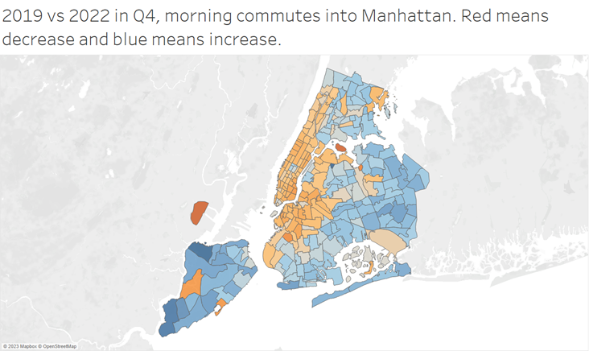
Pandemic commutership change demonstrates divide
Q4 2019 was the last full pre-pandemic quarter and Q4 2022 was arguably the first full post-pandemic quarter.
Between these two quarters:
morning commutership into Manhattan decreased in Manhattan and bordering Brooklyn and Queens – most likely reflecting an increase in remote work.
morning commutership into Manhattan increased in outer borough areas – possibly reflecting a decreased faith in the subway system.
Notes:
*

Slide 23
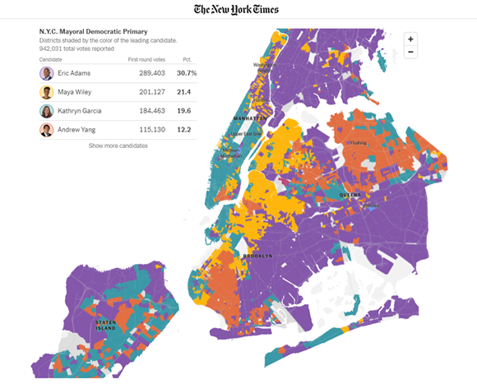
This divide reflects political divisions
In the 2021 Democratic Primary, commuter increase areas tended to vote Eric Adams or Andrew Yang, generally considered more conservative Democrats.
Commuter decrease areas tended to vote Wiley (progressive wing) and Garcia (centrist/technocratic wing).

Slide 24
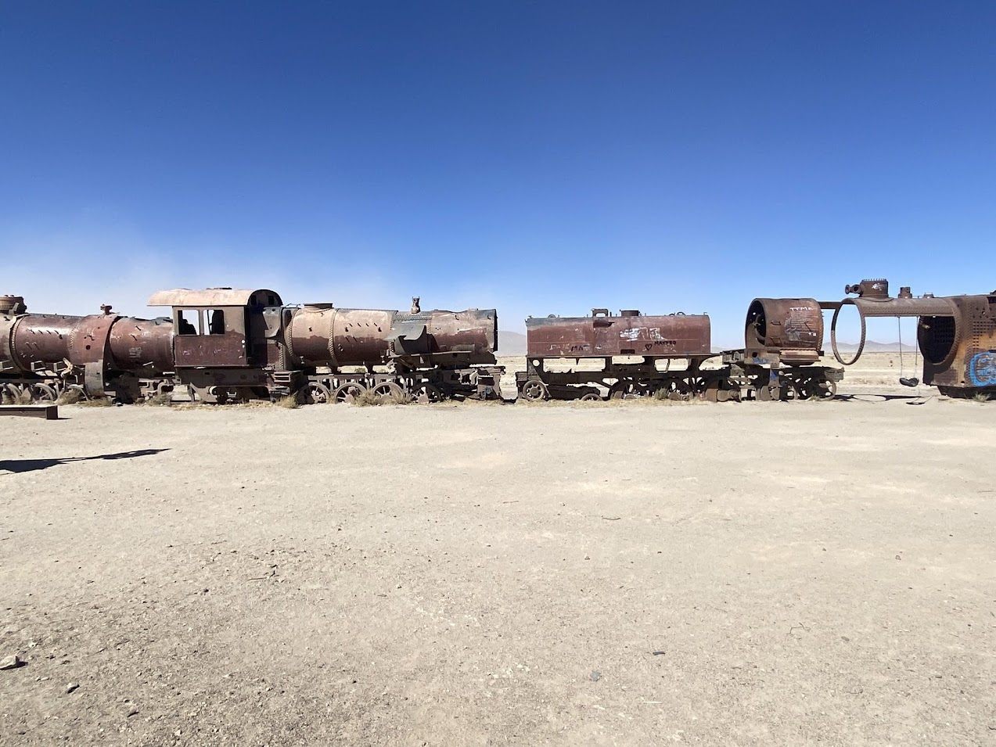
06
Graveyard of
lost slides

Slide 25
Inspiration #2: pundit movement arguing for faster implementation
NYT columnist Ezra Klein: “Everything bagel liberalism” where “[government] tries to accomplish so much within a single project or policy that it ends up failing to accomplish anything at all…one problem liberals are facing at every level where they govern is that they often add too much. They do so with good intentions and then lament their poor results.”
Matt Yglesias on the overusage of courts and public meetings: “We have to trust ourselves to be able to win enough of the argument enough of the time to make the changes we want to see in the country, even knowing that sometimes democratic politics will make the wrong choice. The alternative is endless rounds of stagnation and litigation, arbitrarily advantaging the status quo and whoever has the best lawyers.”
Notes:
Ezra Klein: https://www.nytimes.com/2023/04/02/opinion/democrats-liberalism.html
Matt Yglesias: https://www.slowboring.com/p/community-meetings-arent-democracy

Slide 26
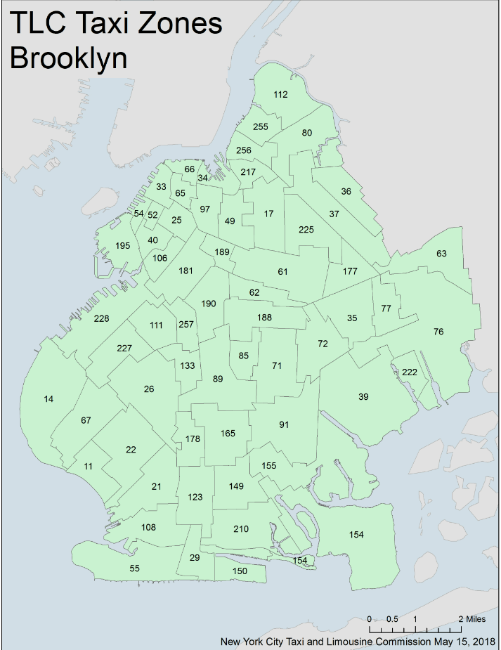
Processing
To process the data into a format I could use:
Rides are from one taxi zone – essentially a neighborhood – to another.
I grouped the data by pickup zone, dropoff zone and month/day/hour – reducing the rows by 90% or more.
Then, I concatenated the data into groups of one or two years from 2017 Q3 to 2023 Q1.

Slide 27
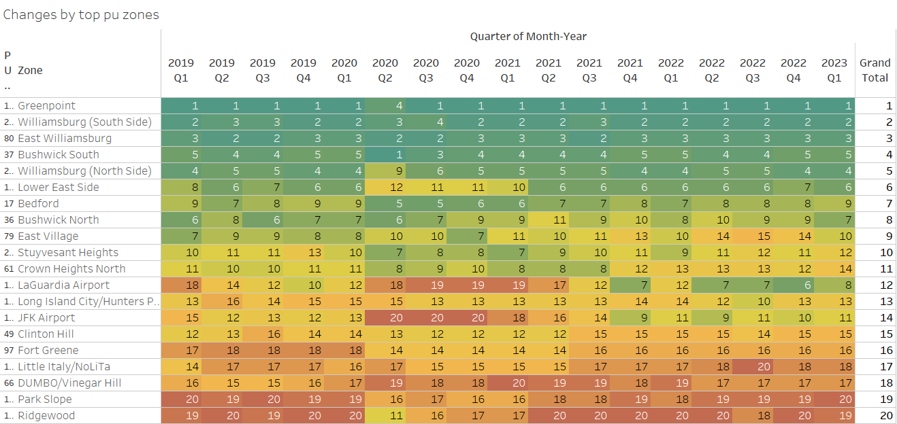
Major movement patterns are often stable
Top pickup zones for South Williamsburg dropoffs stayed stable for the entire period.
Top pickup zones for the dropoff zone Williamsburg (South Side) by quarter
Some changes occurred during the pandemic then reverted.
Some zones did increase or decrease in relative importance as a pickup zone, but changes were usually small.

Slide 28
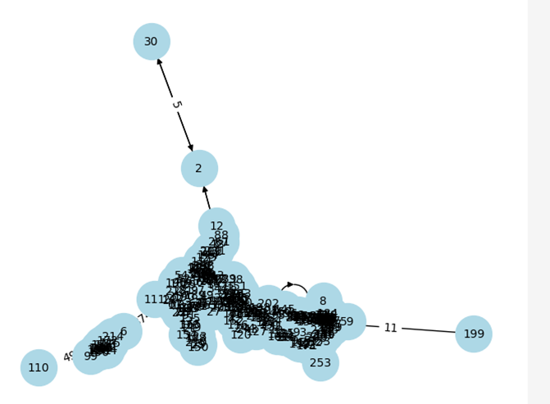
Network of taxi zones in NYC
NYC’s taxi zone network
To the left represents a graph of ‘nodes’ – in this case taxi zones in NYC – and how they connect with one another.
The lines between nodes are called ‘edges.’ Edges can have a ‘weight’ – in this case number of rides between each zone according to public rideshare data.
I created this network with the Python library NetworkX.
Notes:
*

Slide 29
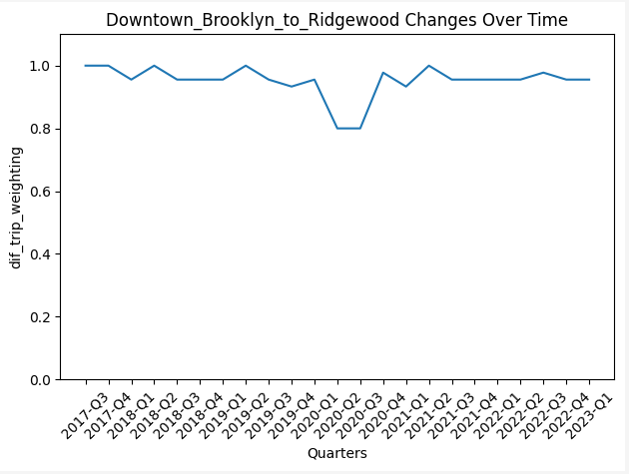
Evaluating the model’s results
First, I simply visualized the change to routes over time and wrote down observations.
Then, I quantified change in route by looking at percentage of commutes in each route compared to the first evaluation.
Finally, I graphed these changes for each of the 15 routes (one is to the right).
Notes:
*

Slide 30
All conclusions
Conclusion #1: The routes produced by the ‘best bus route’ algorithm are generally static over 5-year periods, indicating an underlying stability to NYC’s traffic patterns.
Conclusion #2: Pandemic change was mostly temporary.
Conclusion #3: While not the rule, some routes do change over time, and a third of routes were showing signs of broader, permanent change after 5.75 years.
Conclusion #4: Reducing trips and reducing economic waste on rideshare rides are not at odds: both algorithms created similar routes.

Slide 31
Conclusion #2: Pandemic change was mostly temporary.

Slide 32
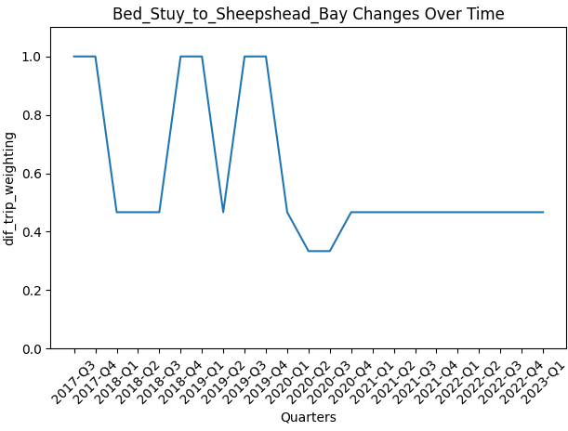
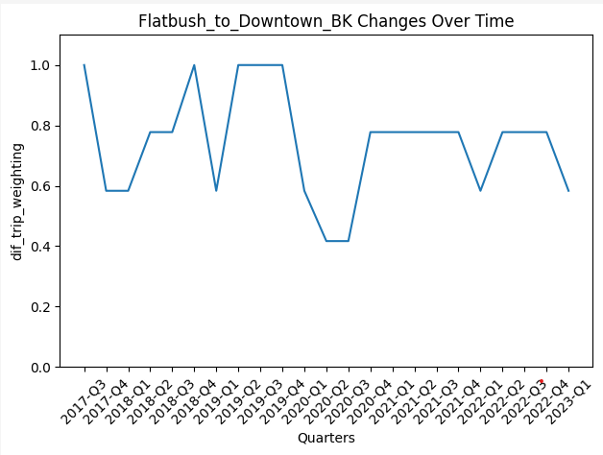
Conclusion #3: While not the rule, some routes do change over time.
This graph reflects the algorithm’s change from looping around Bushwick in northern BK to southern BK neighborhoods of East NY and Brownsville.
This graph reflects the algorithm considering several different routes and ultimately going back and forth between two that take the ‘bus’ through Stuyvesant heights.

Slide 33
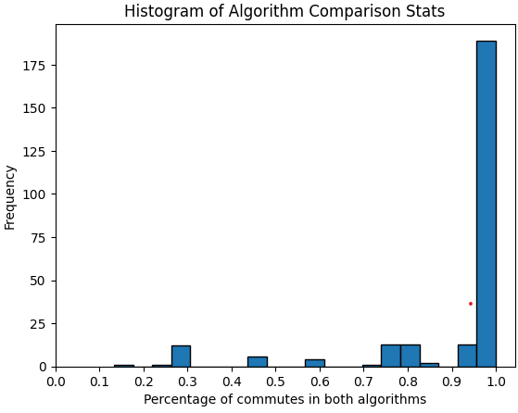
Conclusion #4: Optimizing for number of rideshares and rideshare cost produced similar results.
Of the 255 times the best route algorithm was run separately using both weights (total ride fare and total rides): it came up with a route > 90% similarity 79% of the time.
In other words: if you optimize to reduce traffic, you will usually optimize to reduce the amount of money people spend on rideshares.

